Slide 1
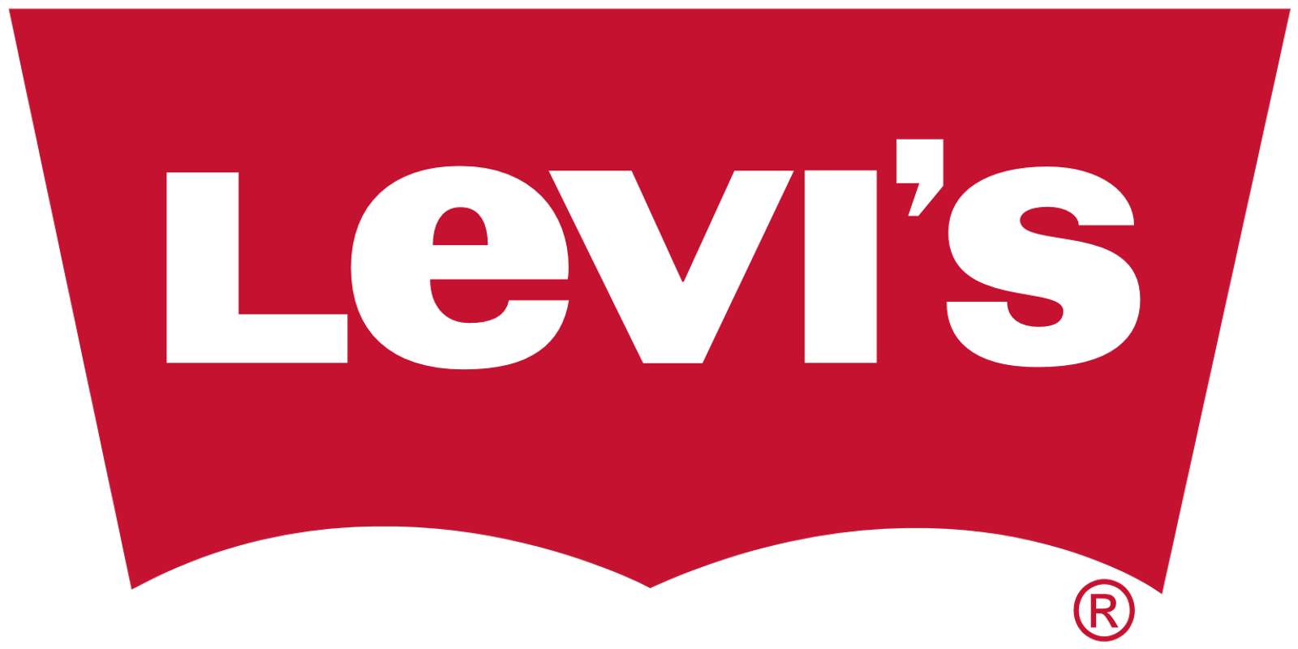
Marketing Analytics for Levi Strauss & Co.
Team Members: Sirisha Gadepalli, Richa Sethi, Chi-Chien(May) Tsai, Merve Ucmaz

Slide 2
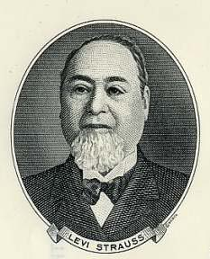
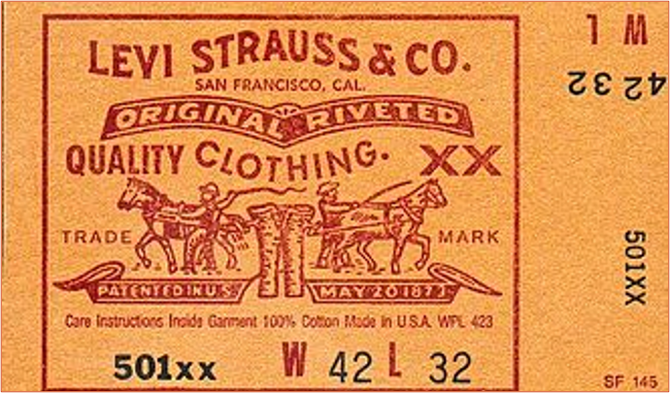
Company Overview- Background
Levi Strauss & Co. is an American clothing company known worldwide for its Levi's brand of denim jeans.
Founded in May, 1853 when German immigrant Levi Strauss came to San Francisco, California to open a west coast branch of his brothers' New York dry goods business.

Slide 3
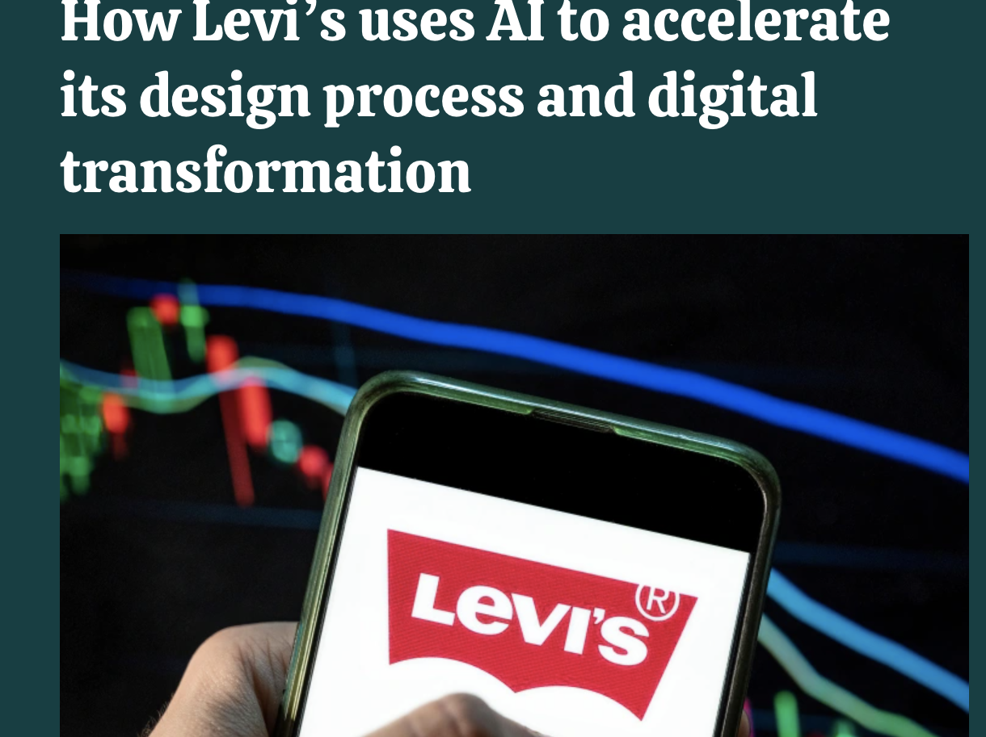

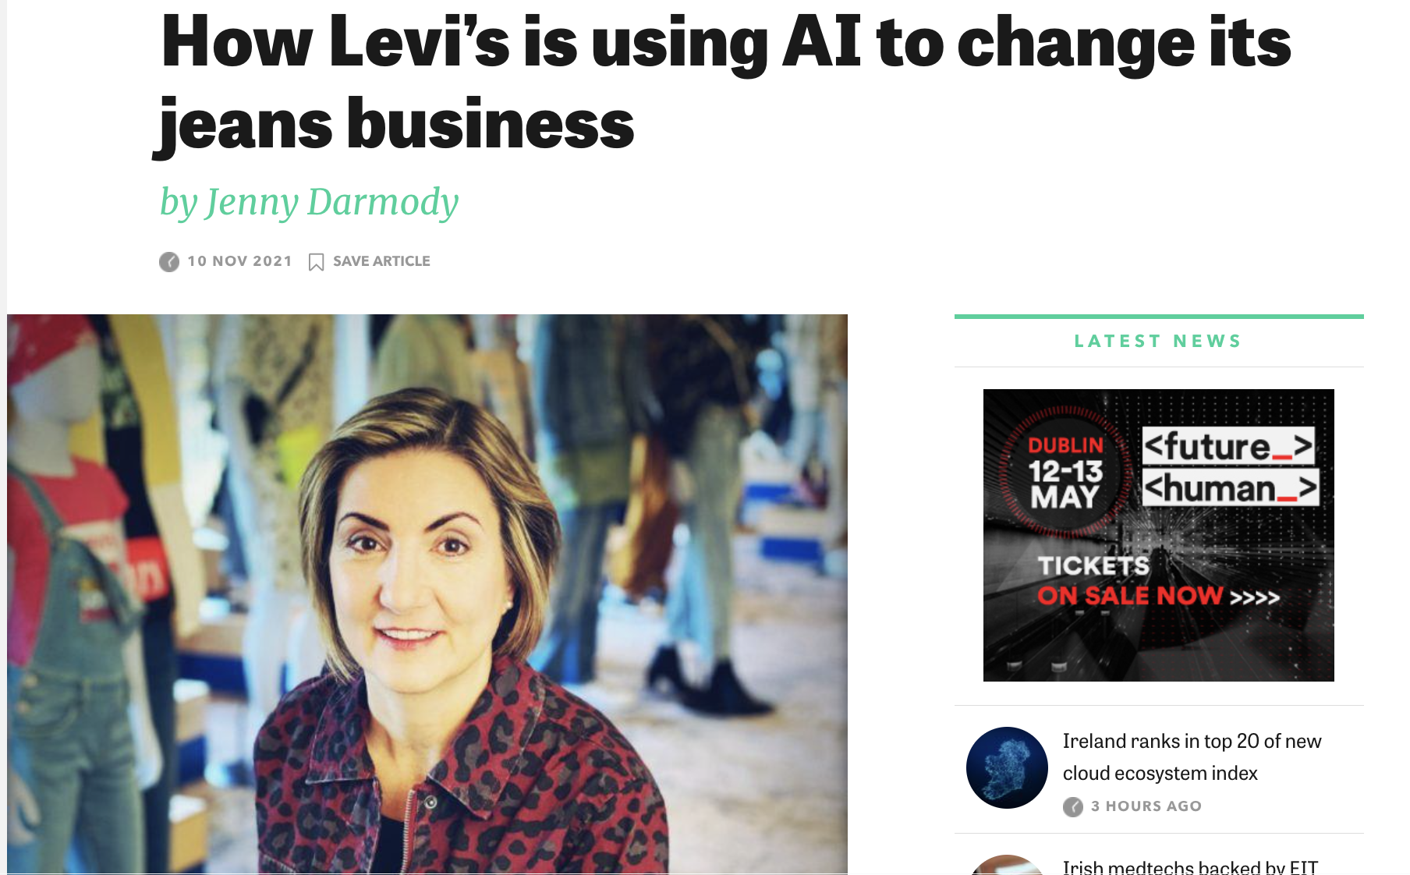

COMPANY OVERVIEW- New Direction
1. Automating commerce
Create an algorithm to help with in-store product recommendations
2. AI-powered design for optimization
Turning painting into jacket
Notes:
https://www.siliconrepublic.com/machines/levis-ai-data-analytics-katia-walsh
https://venturebeat.com/2022/02/28/how-levis-uses-ai-to-accelerate-its-design-process-and-digital-transformation/

Slide 4
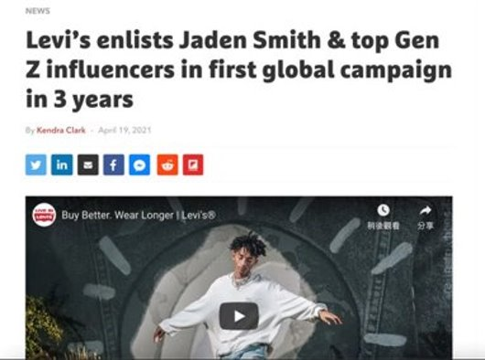
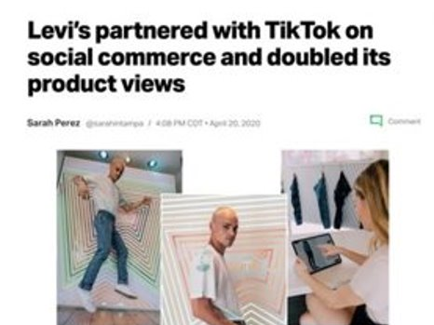
COMPANY OVERVIEW- New Direction
2021 April:
Collaborated with Gen Z influencers like Jaden Smith in their first global campaign
Partnered with TikTok influencers on Social Media
Notes:
https://www.thedrum.com/news/2021/04/19/levi-s-enlists-jaden-smith-top-gen-z-influencers-first-global-campaign-3-years

Slide 5
Hypothesis
Hypothesis 1
Hypothesis 2
Sustainability concept on the marketing campaign is contribute
the most to the popularity of the tweet.
The popularity of tweet and the return of stock is positively correlated.

Slide 6
DATA ANALYSIS Process
Extraction
Modeling
Inference
Data Cleaning
Word Cloud
Notes:
Retweet of likes & Categories of marketing campaign

Slide 7

DATA ANALYSIS SOLUTION
Extraction: Extracting tweets using Twitter API and package tweepy; Extraction of stock data using Yahoo Finance
Data Cleaning: Filter, Clean Text data using NLTK, Remove nulls, Aggregation
Word Cloud: Trends Patterns
Modelling: Linear Regression
Inference: Results Interpretation and hypothesis validation
Notes:
Retweet of likes & Categories of marketing campaign

Slide 8

Data Cleaning: Text Analysis for word cloud
Step1. Data Cleaning on retweet_description column [ e.g. stopwords, cleaning up emojis and special letters ]
Step2. Print out most common 30 words from Levis tweets to see the patterns
Step3. Turn most common 30 words into a pd series called freq
Step4. Select all the words that is not in the freq pd series

Slide 9
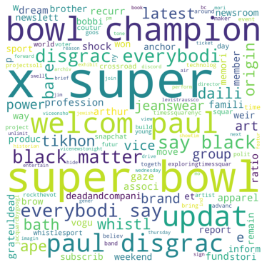
Word Cloud
Super Bowl
Levi's Stadium- Home of San Francisco 49ers
Celebrity
Levi's collaborate with RuPaul's Drag Race
Black matters
Levi's publicly support on Black lives matter
Notes:
Retweet of likes & Categories of marketing campaign

Slide 10
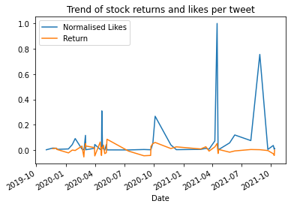
HYPOTHESIS 1 RESULT
While all the peaks of our graphs seem to be correlated with the returns on the stock, I.e., high correlation, example; presidential election.
Corr: 0.246
Notes:
Retweet of likes & Categories of marketing campaign
Collaboration of the ban Niner Gang with the San Francisco 49ers football team
The peak around Sept and October 2020 shows a peak as it was during the Presidential Elections in the USA
The peak around April 2021 was NRG esports collaboration with Levis which was off to a very strong start.
The final peak in August 2021 was Levis collaborating with RuPaul's Drag Race which was their initiative to support the LGBTQ+ community

Slide 11
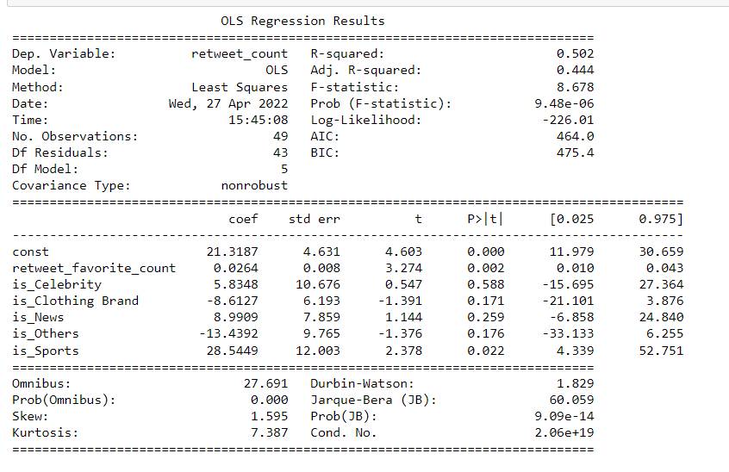
HYPOTHESIS 2 RESULT
Popularity of tweets ie. Retweets is impacted significantly based on likes received on tweets and if the tweet is related to sports.
More the likes, more retweets
Sport tweets are retweeted more
Notes:
Retweet of likes & Categories of marketing campaign

Slide 12

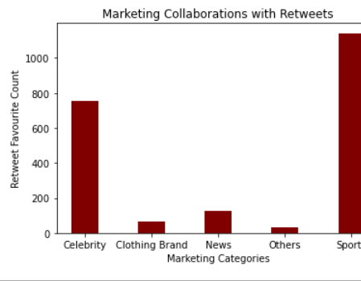
HYPOTHESIS 2 RESULT
The results of our analysis indicate that marketing collaborations with Sports brands generates maximum customer engagement.
This is followed by collaborations with celebrities, genZ influencers and other entertainment industries.

Slide 13
OUR RECOMMENDATIONS
Our conclusion indicates that sports collaborations have a much higher contribution to consumer engagement.
Sports and the entertainment industry whose huge contributions could equally be involved in promoting social and political causes which could enhance user engagement.
Levis should experiment with the content and reach of their environmental initiatives to increase their popularity.
Notes:
Retweet of likes & Categories of marketing campaign

